Slide 1
Introduction to oncology :
Dr. maher jabbar salih
2022-2023
Lecturer medical oncologist .
MBCHB .FICMS –ONCO. ESMO

Slide 2
Oncology is the study and treatment of cancer, and their related diseases. “
Onkos = Greek name means mass
A neoplasm or tumor is an abnormal uncontrolled growth of cells which develop faster than the surrounding normal tissues.

Slide 3
NEOPLASIA …………
HYPERPLASIA …………..
HYPERTROPHY …………..

Slide 4
DYSPLASIA :

Slide 5
CARCINOMA IN SITU :

Slide 6
METAPLASIA :

Slide 7
Benign tumors often grow slowly and are discrete and encapsulated. They are often free moving from surrounding tissues .
Malignant tumors may either grow quickly or slowly. They may have a defined capsule and be attached to surrounding tissues. These tumors can also metastasize to other organs such as the lungs, spleen, liver, bone, and/or brain. The rate of metastasis varies by tumor classification.
Carcinoma – A malignant tumor arising from epithelial cells.
Squamous cell carcinoma – Oral cavity
Transitional cell carcinoma – Bladder
Adenocarcinoma – Glandular tissue in epithelia

Slide 8
CARCINOMA VERSUS SARCOMA
Sarcoma – A malignant tumor arising from mesenchymal tissues
Lymphosarcoma – Lymphoid tissue may be associated with feline leukemia virus in cats.
Fibrosarcoma – Arises from fibroblasts and may be found in connective tissue.
Osteosarcoma – Tumor of osteoblasts and is usually in the limb bones.

Slide 10
Pathogenesis :
Genitic causes ………….
Environmental causes ……………… benzene , virus , h. pylori ….

Slide 11
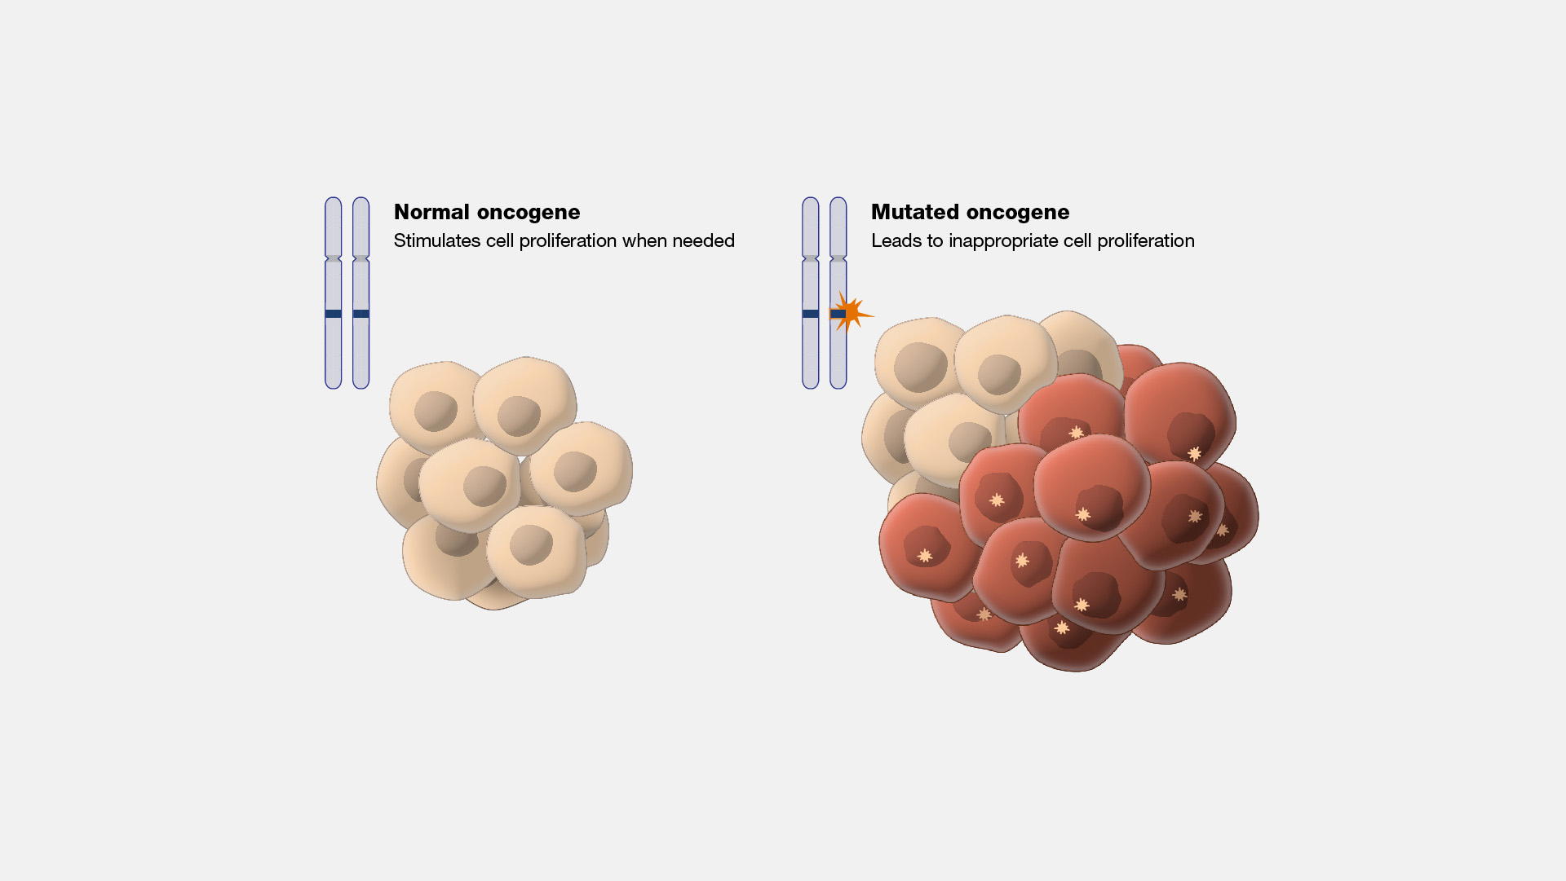
INVOLVED GENES :
ONCOGEN
TUMOUR SUPPRESSOR GENES

Slide 13
Life style :
Smoking …………
Alcohol …………..
Afla toxin …………
Obesity ………….

Slide 14
Occupational causes :
Aniline dye ……… bladder ca
Asbestose ………. Mesothelioma
UV light ……………. Skin

Slide 15
Pathology :
DIRECT
INDIRECT

Slide 16
PARANEOPLASTIC MANIFISTATIONS :

Slide 17
Prevention :
Modification of the risk factors ………… ?
Vaccination … HPV 16-18 ?
PROPHYLACTIC SURGERY …. ?

Slide 19
Dx :
HISTORY
EXAMINATION
INVESTIGATIONS

Slide 20
There are different ways of obtaining a tissue for histopathology.
Fine-needle aspirate – FNA can be used to screen primary lesions for the presence of cancer, or in the staging process to determine whether lymph nodes or other secondary sites are involved.
Bone marrow biopsy – Aspirates are used to remove a bone marrow sample using a bone marrow needle.
Needle core biopsy – A small cylinder of tissue is obtained using a specialized instrument such as a Tru-Cut needle.
Punch biopsy – Punch biopsies are taken using small circular cutters, from superficial lesions in the skin.
Trephine biopsy – Trephine biopsies are taken from bony tumors using a Trephine or a Jamshidi needle.
Incisional biopsy – A wedge of tissue is taken from a part of the tumor that appears to be actively growing and then the wedge is repaired with sutures.
Excisional biopsy – This is usually used for small tumors that are easy to remove with a margin of normal tissue, particularly if it is suspected the tumor is benign.
Endoscopy – These samples are very small and are best handled with a fine-gauge needle.

Slide 21
IMMUNOHISTOCHEMICAL STAINING :

Slide 22
TUMOUR MARKERS :

Slide 24
STAGING SYSTEM : ……….. TNM

Slide 25
TREATMENTS :

Slide 26
THANK YOU

